Slide 1
Overcoming Underachievement: Nurturing a Resilient Mindset
Sam Goldstein Ph.D.
Assistant Clinical Professor of Psychiatry,
University of Utah
www.samgoldstein.com

Slide 2
There is an inflation of stress and risk facing our children. Not surprisingly there is also an inflation of mental illness.

Slide 3
The Future

Slide 4
The purpose of life is to prepare the next generation for their future.

Slide 5
Survival of the Species
Salmon and snakes are born with sufficient instincts to survive.
Bear cubs require at least one or two years with their mother to insure survival.
Higher primates require three or four years.
Humans require at least ten years.

Slide 6
A Man Goes Fishing

Slide 7
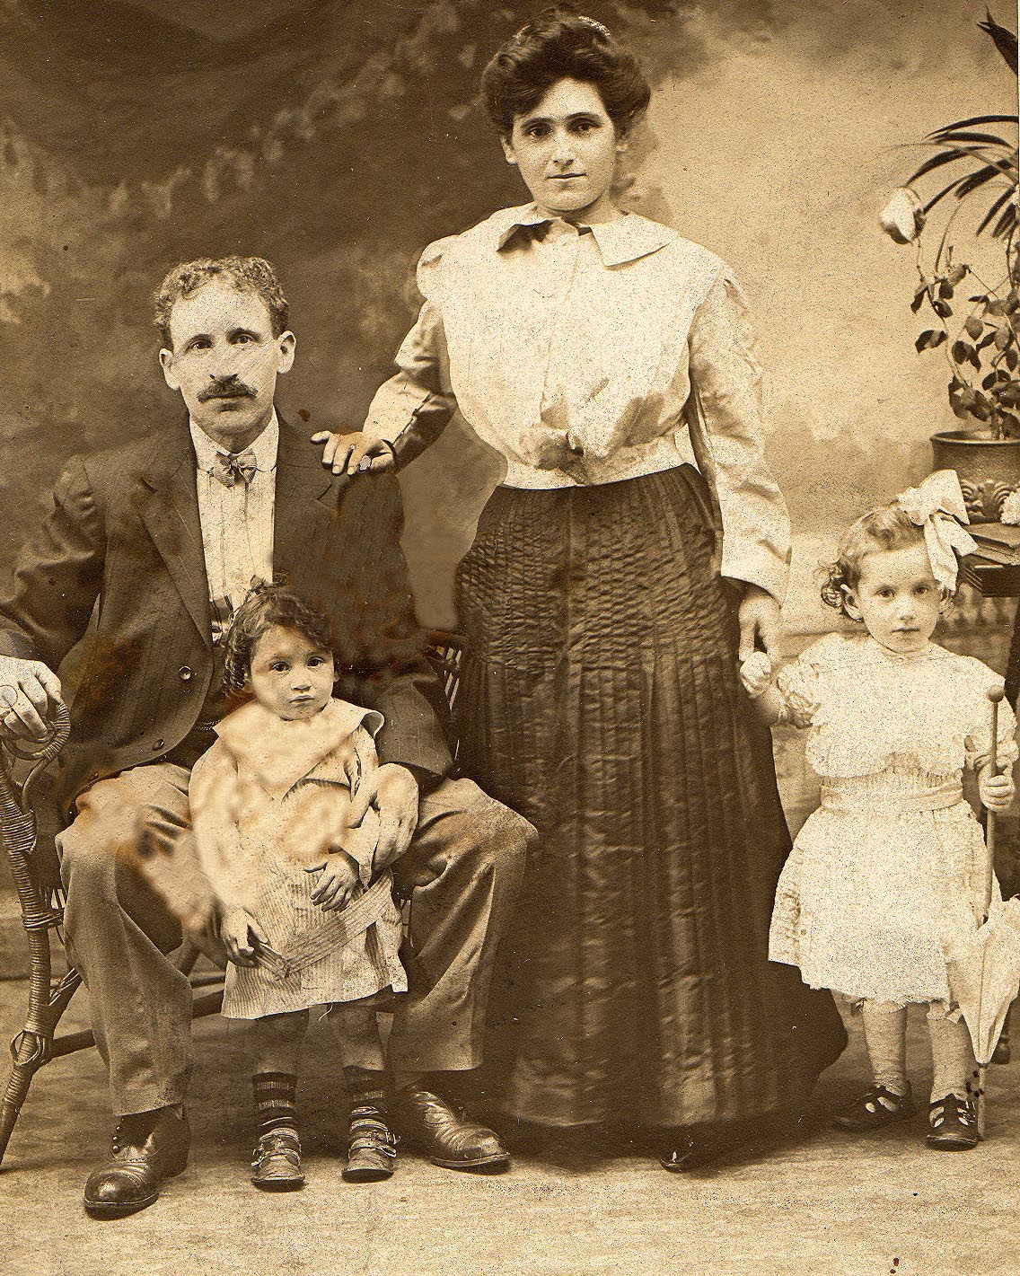
My Grandparent’s Future

Slide 8
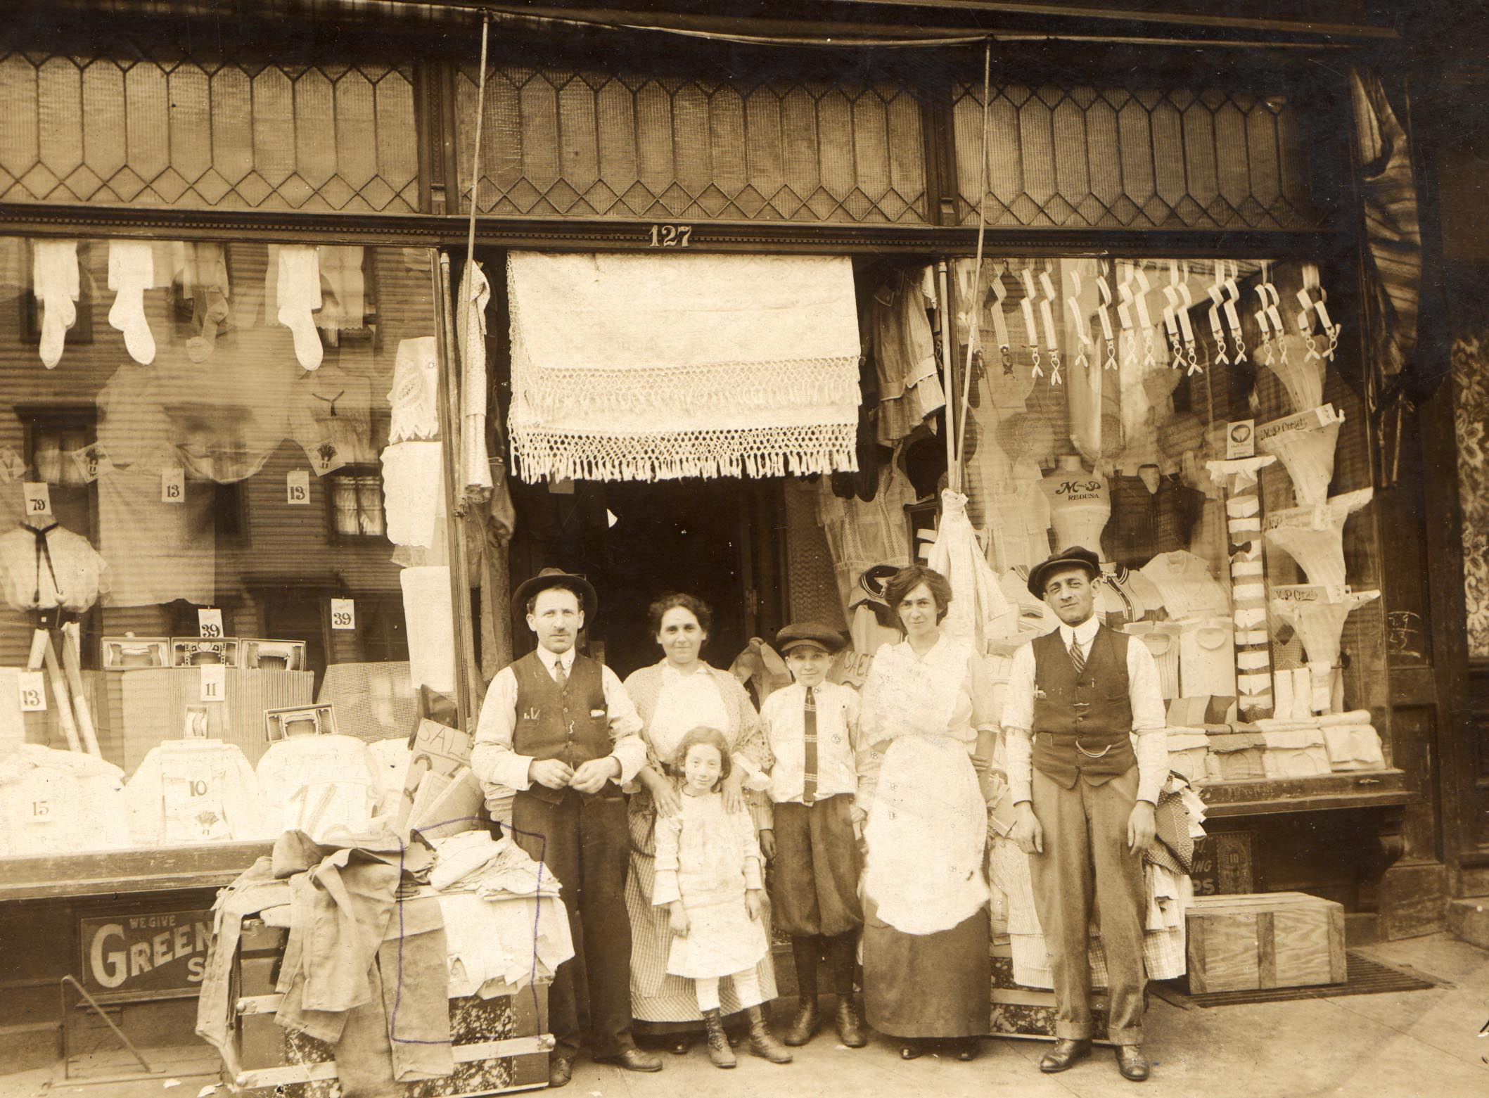
My Grandparent’s Future

Slide 9
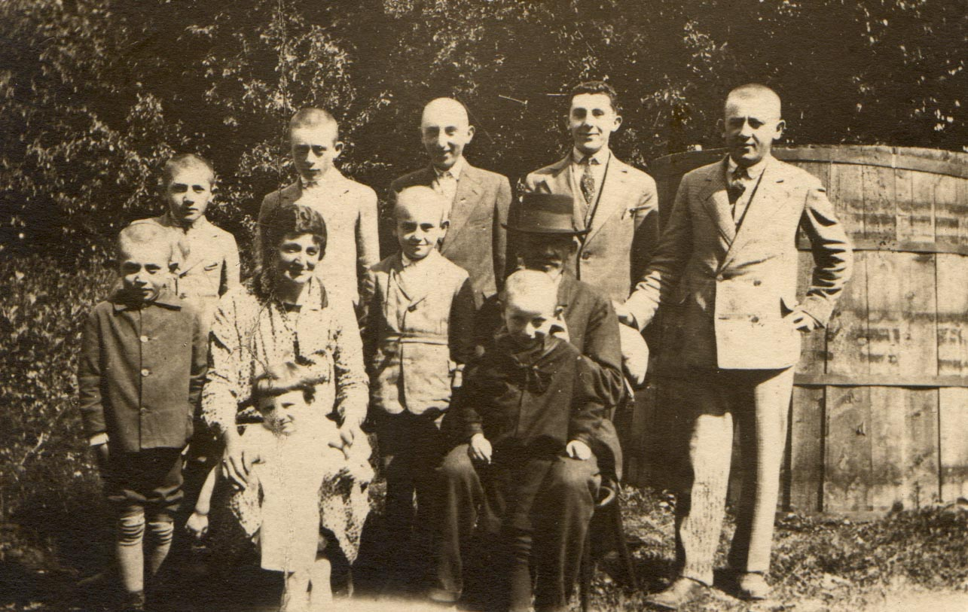
My Grandparent’s Future

Slide 10
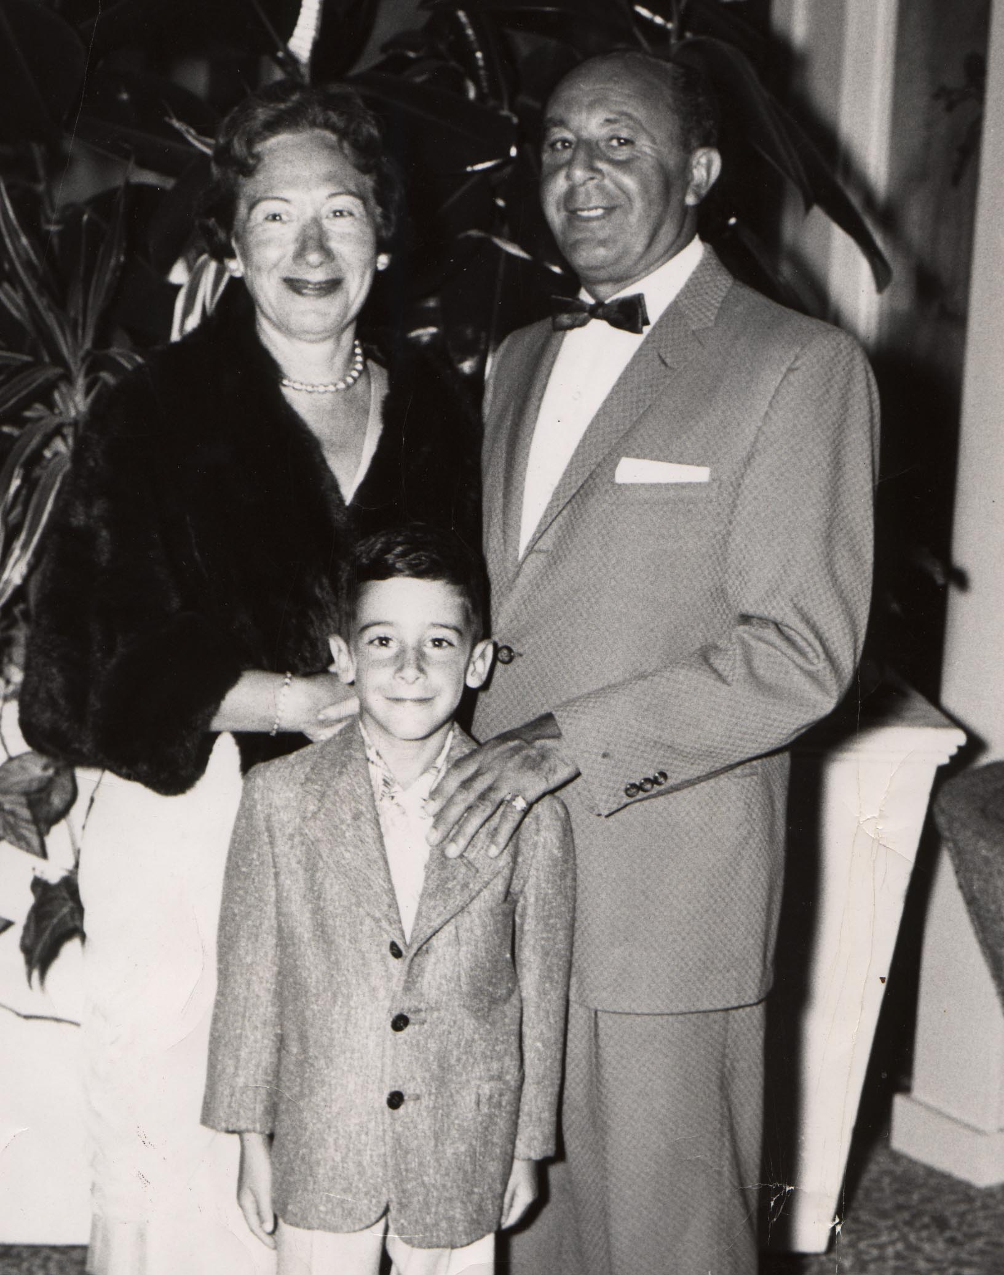
My Parent’s Future

Slide 11
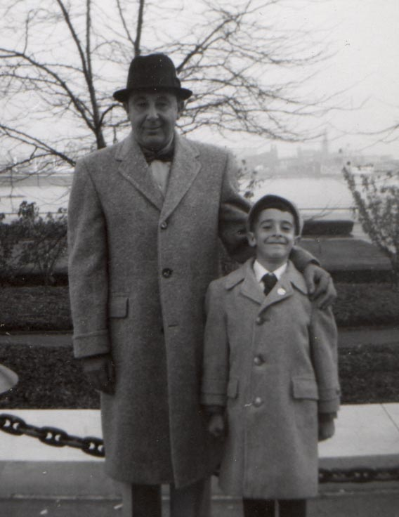
My Parent’s Future

Slide 12
My Future

Slide 13
Caregivers are the architects of the way in which experience influences of genetically preprogrammed but experience dependent brain development.
Daniel Siegel
The Developing Mind

Slide 14
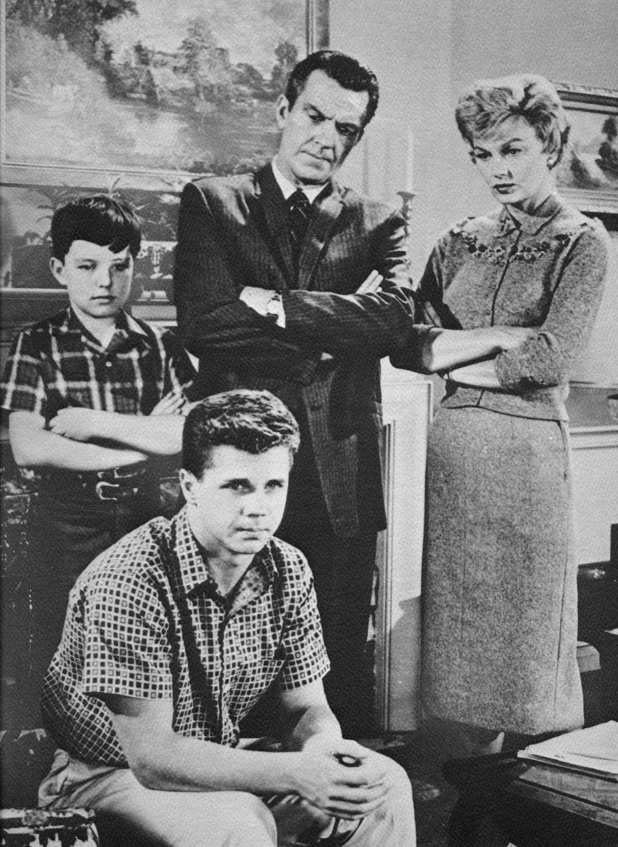
B.C. Life Before Children or. . .
BEFORE CHAOS!

Slide 15
Before Children
When you believed all your dreams and wishes about parenting and children would come true!

Slide 16
The Kind of Parent You Promised to Be
Loving and patient
You would explain not order
You would discuss not overpower
You would be patient
You would remain calm
You would be consistent
Neither too lenient nor too strict and….

Slide 17
YOU WOULD NEVER GET ANGRY!

Slide 18
Why is it so hard to keep our promise?
Raising children requires long hours.
Children are messy. You must pick up, wipe up, clean up, organize, support and supervise.
Children are noisy and disturb our peace.
Caring for children requires time consuming tasks such as laundry, shopping, cooking and driving.

Slide 19
Why is it so hard to keep our promise?
Children are self centered. Their needs come before yours.
In their quest for independence children test limits and our patience.
Children require large amounts of attention, approval and support.
Children of all ages require supervision
Some children are difficult to understand.

Slide 20
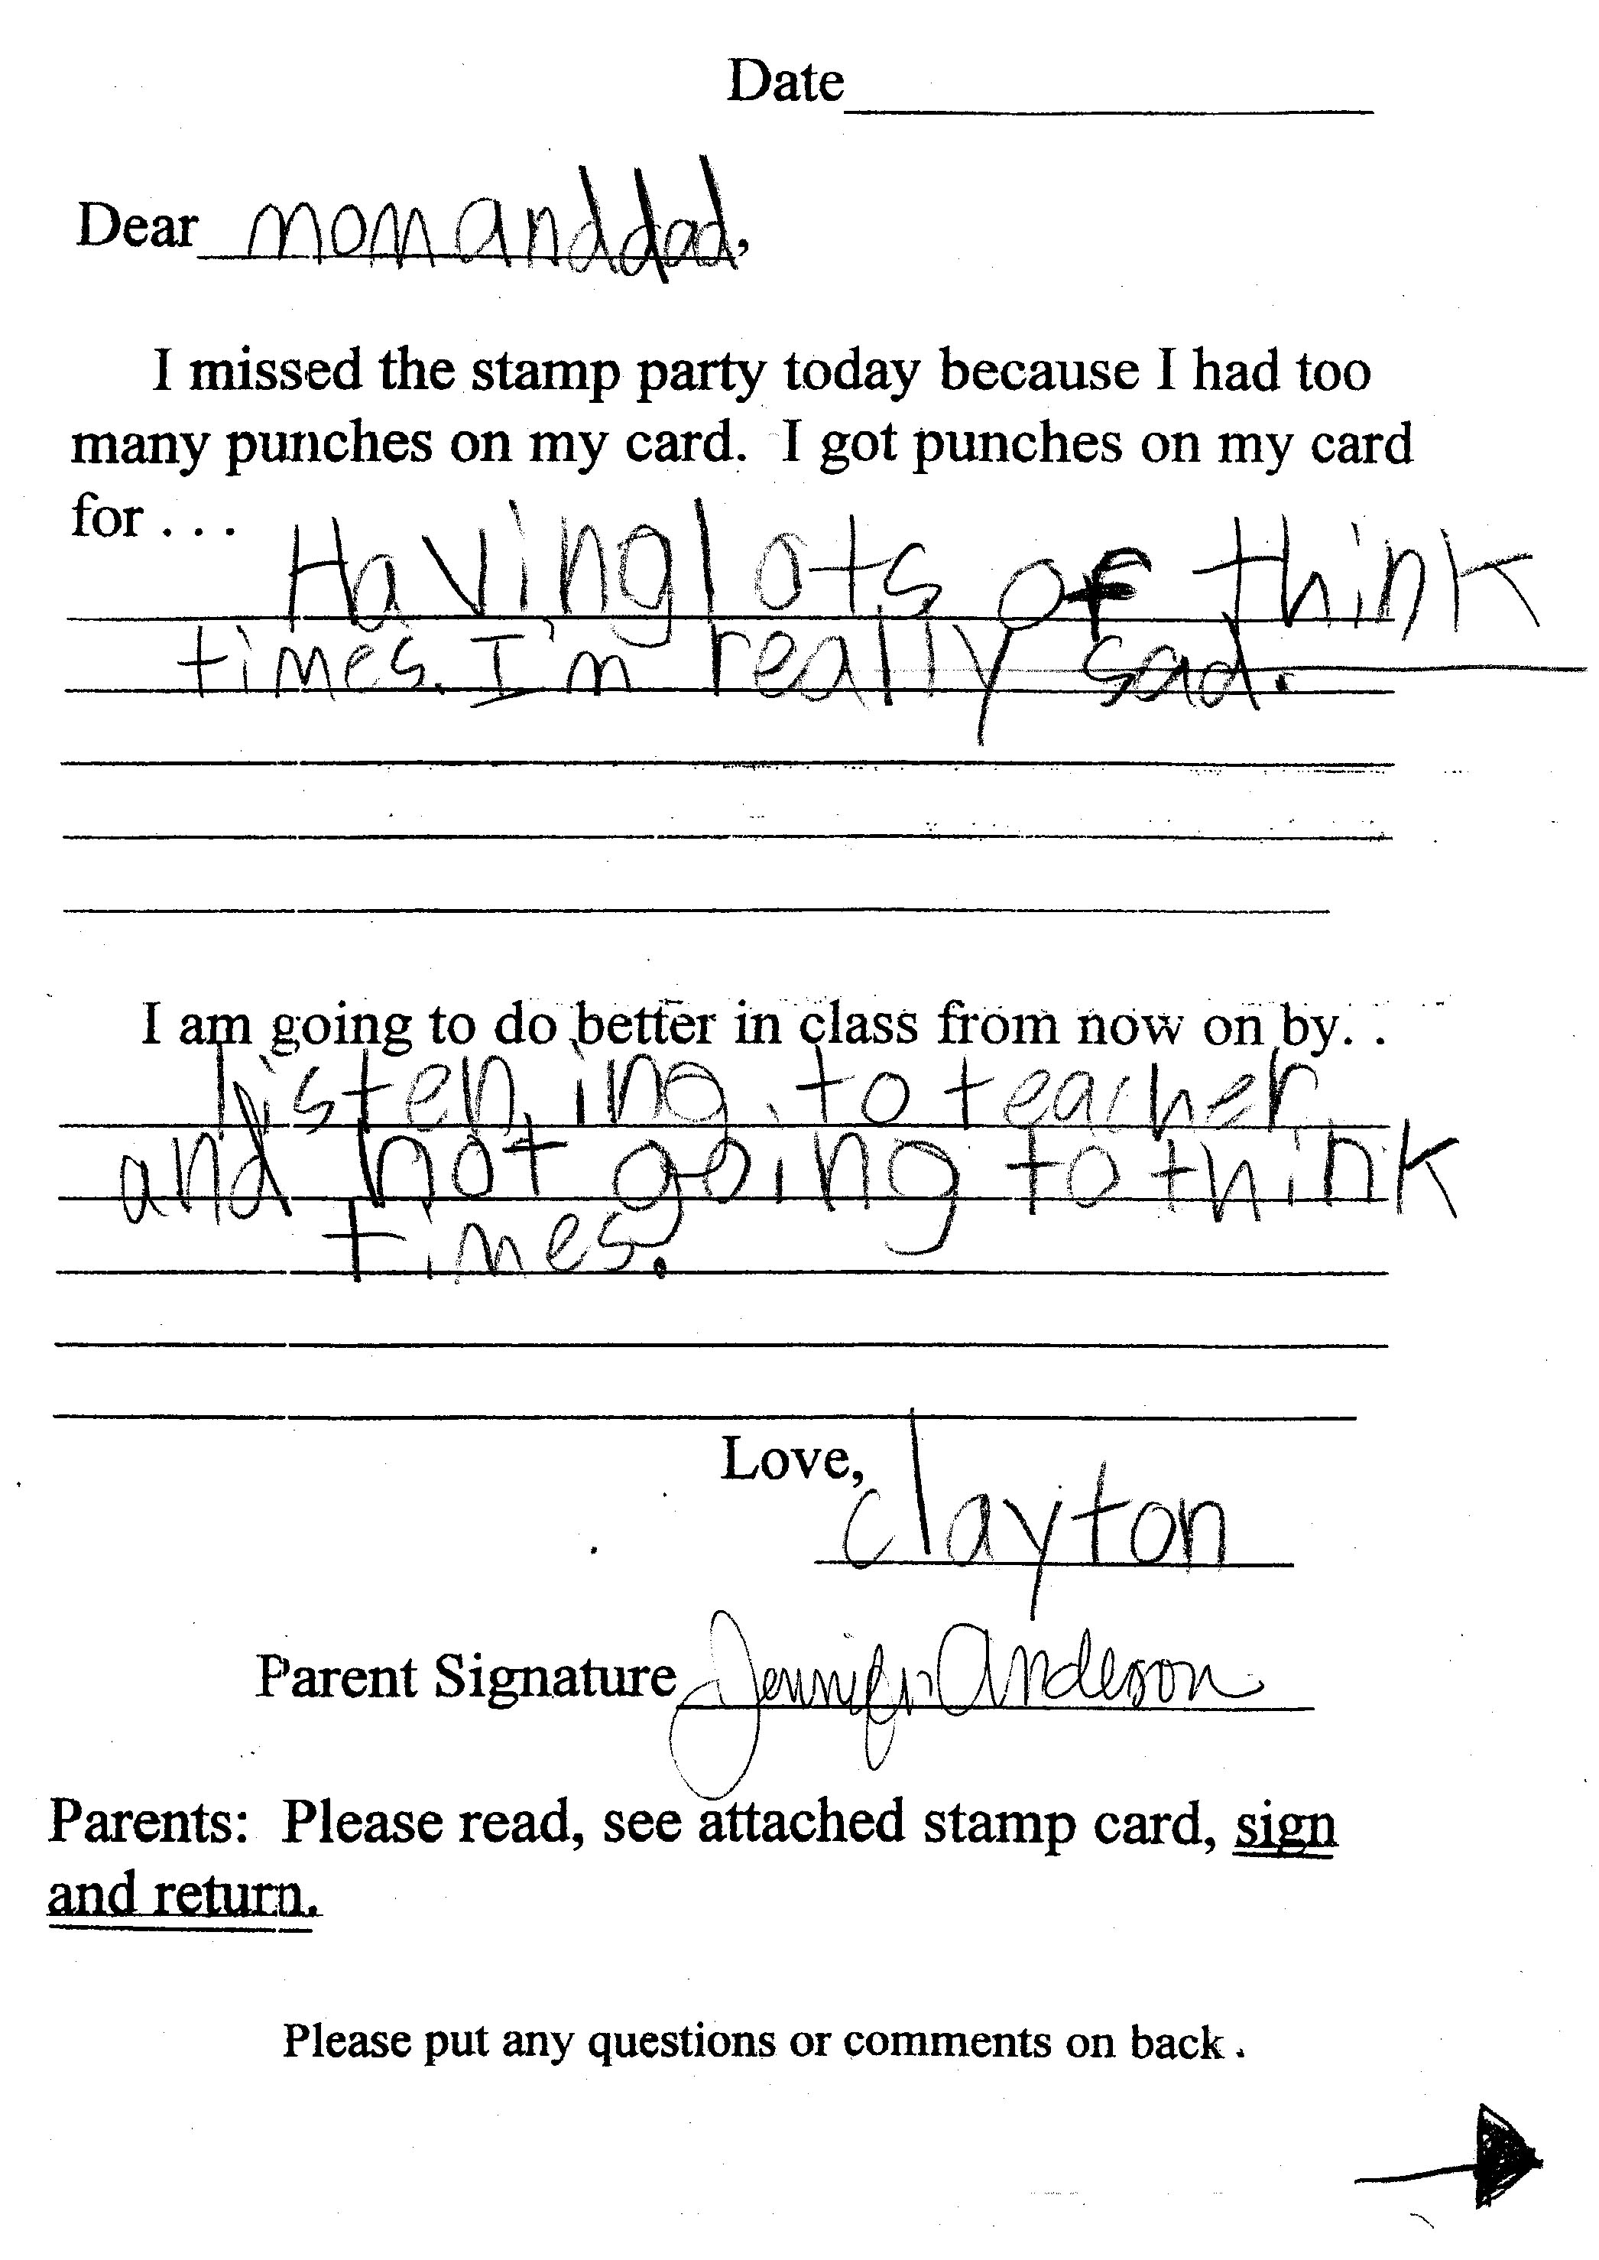
Clayton Cares

Slide 21
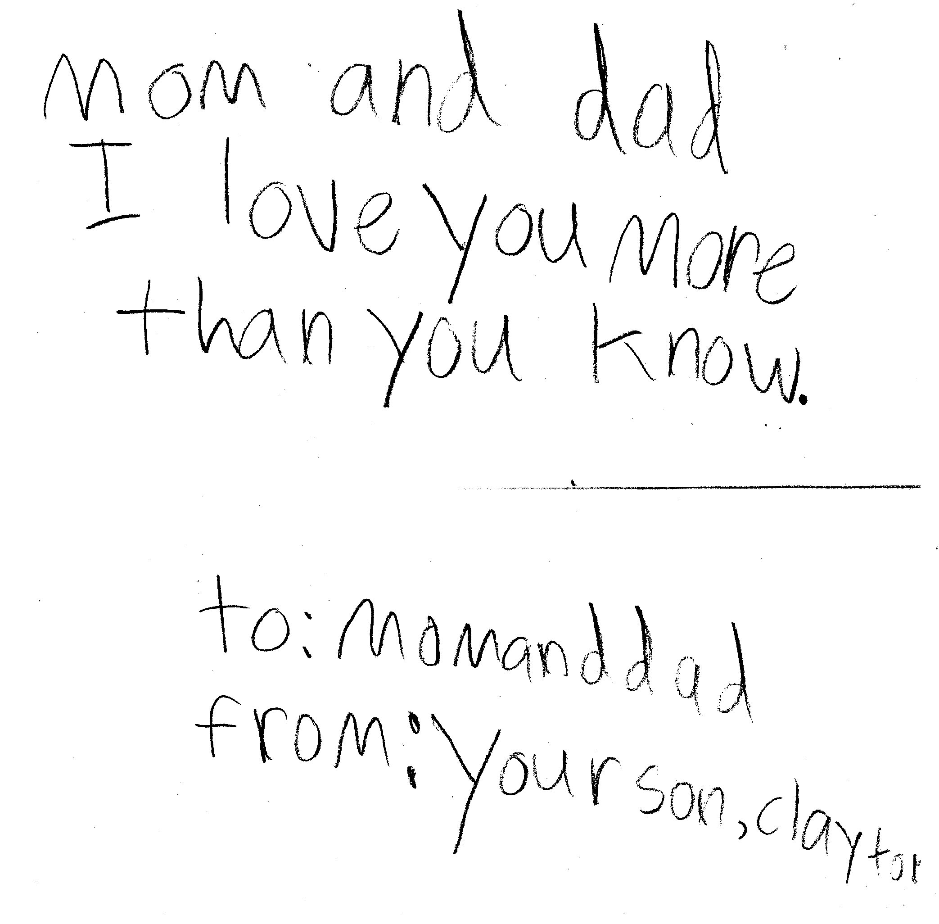

Slide 22
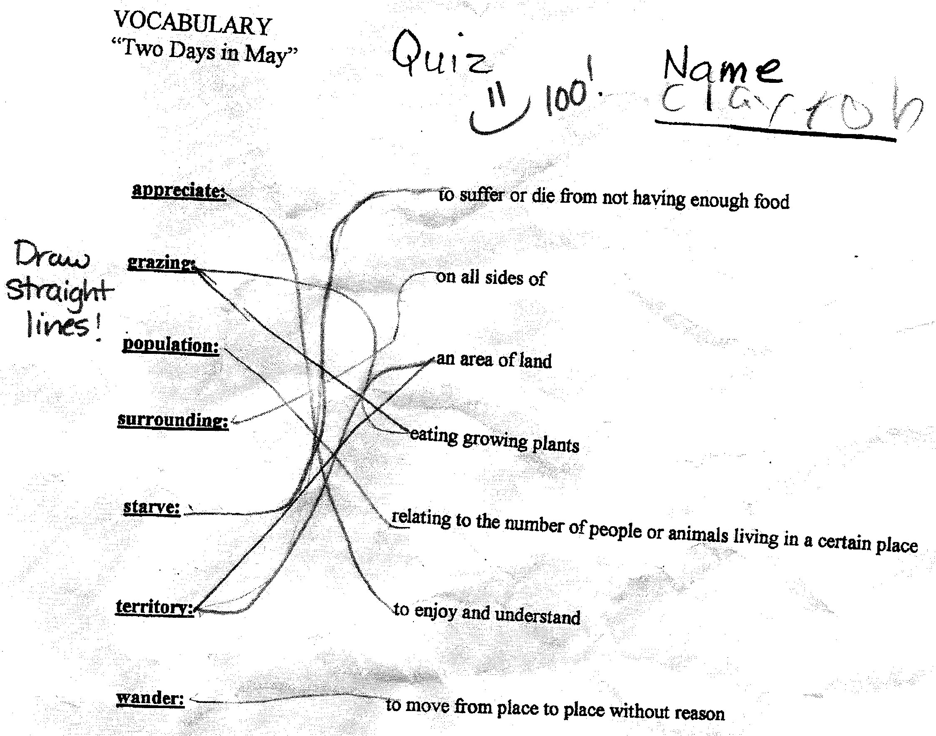
Clayton Can’t Get a Break

Slide 23
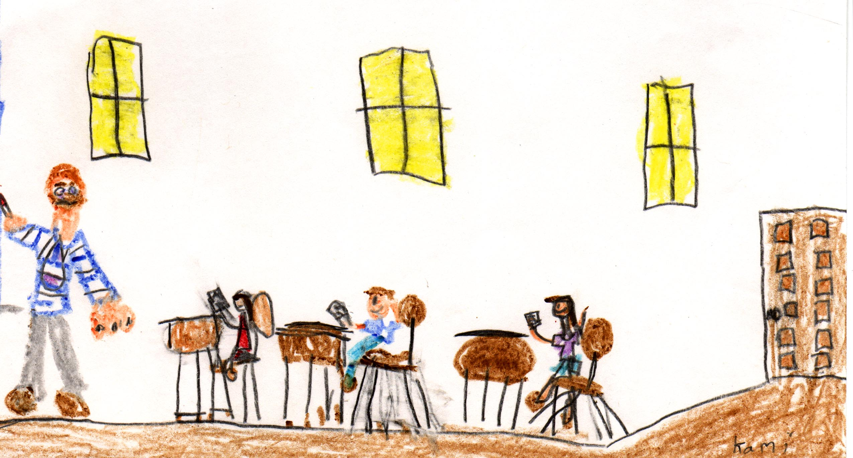
We can’t keep our promise by adopting a deficit model!

Slide 24
Did you ever wonder . . . ?

Slide 25
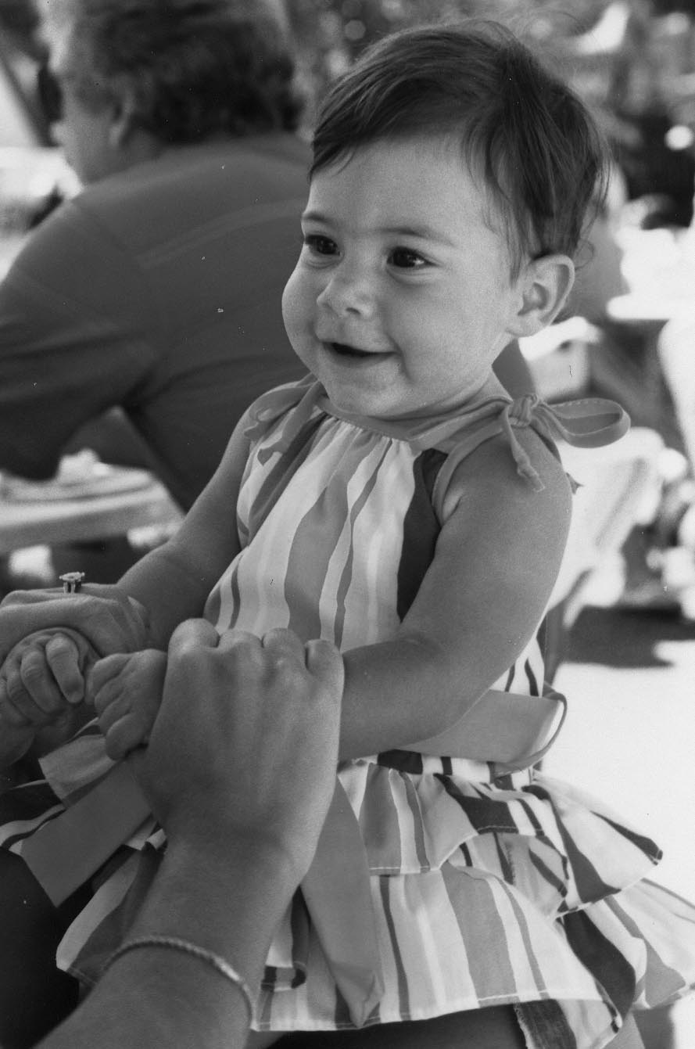

Slide 26
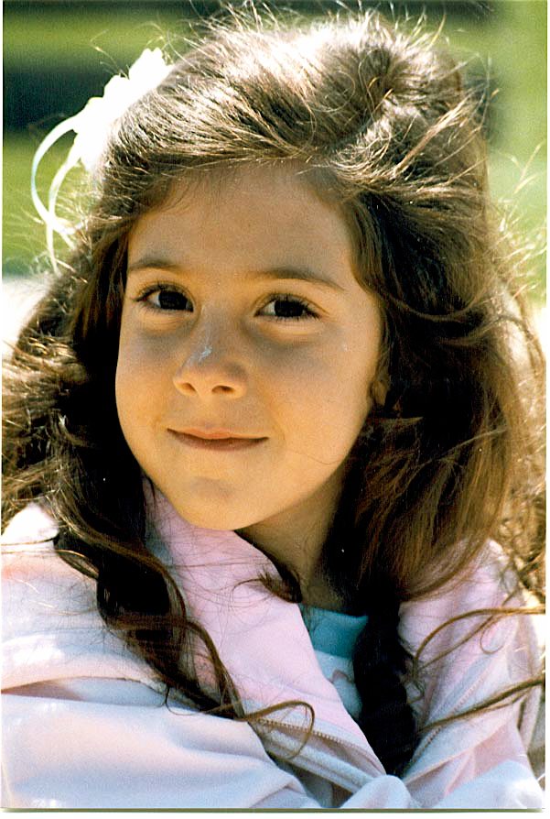

Slide 27
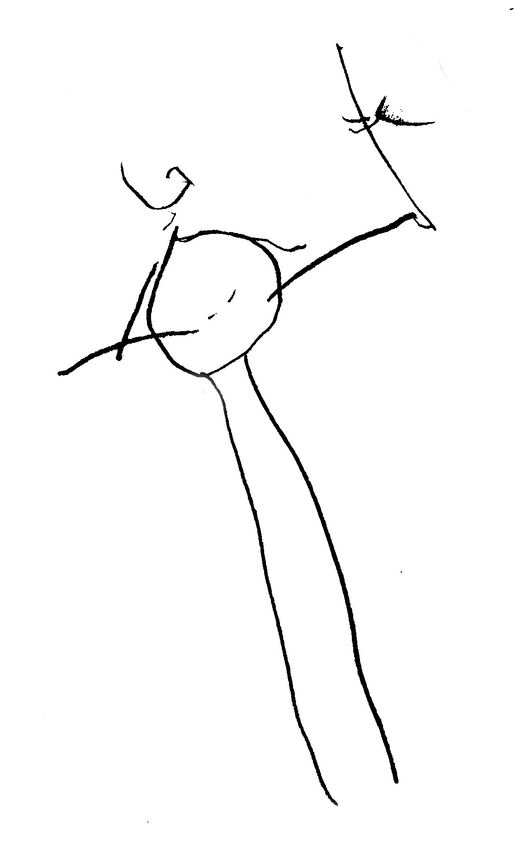
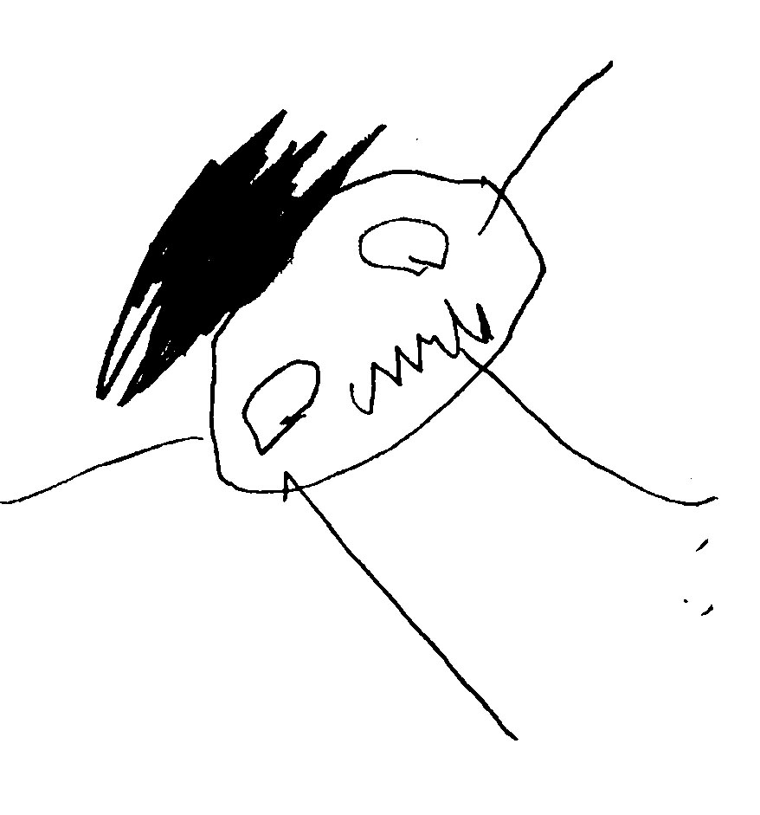

Slide 28
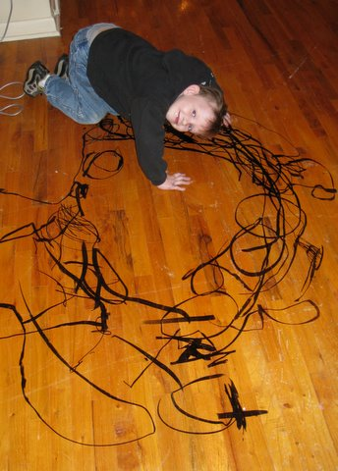

Slide 30
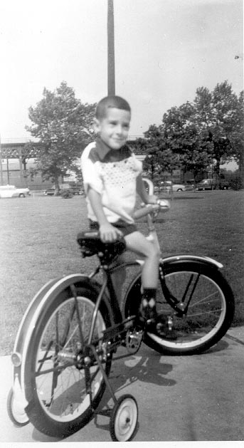

Slide 31
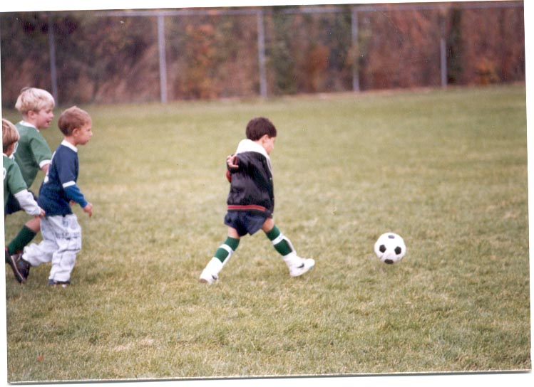

Slide 33
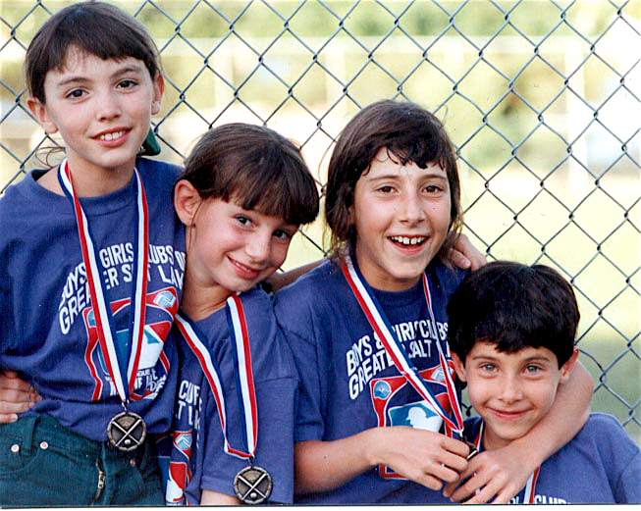

Slide 34
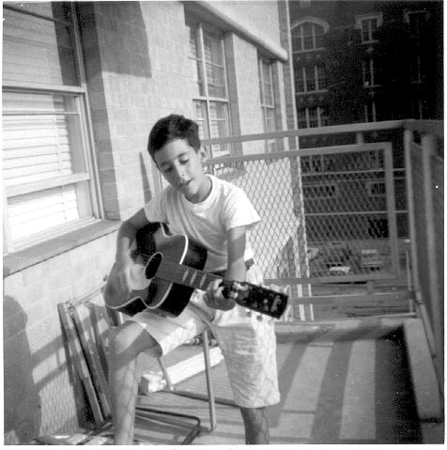

Slide 35
Instinctual Optimism & Intrinsic Motivation

Slide 36
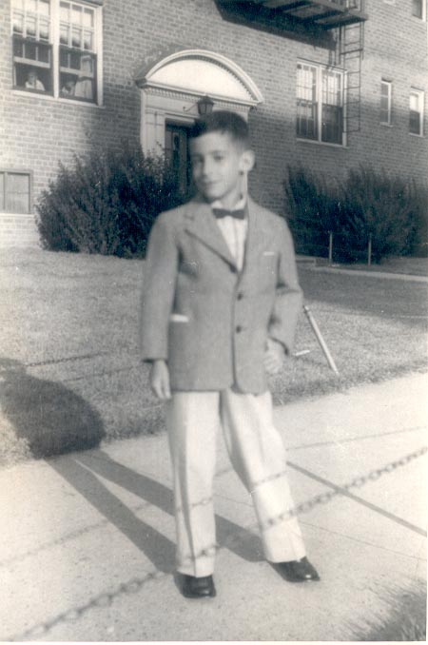

Slide 37
Resilience is a pattern of positive adaptation in the context of past or present adversity.

Slide 38
Good Coping = Resilience

Slide 39
Instinctual optimism and intrinsic motivation can be understood as vital components guiding human development, self-discipline, a sense of ownership and responsibility for one’s behavior.

Slide 40
Instinctual optimism and intrinsic motivation serve as the fuel for a resilient mindset.

Slide 41
Kindergarten Graduation

Slide 42
How Will They Feel in Five Years?

Slide 43
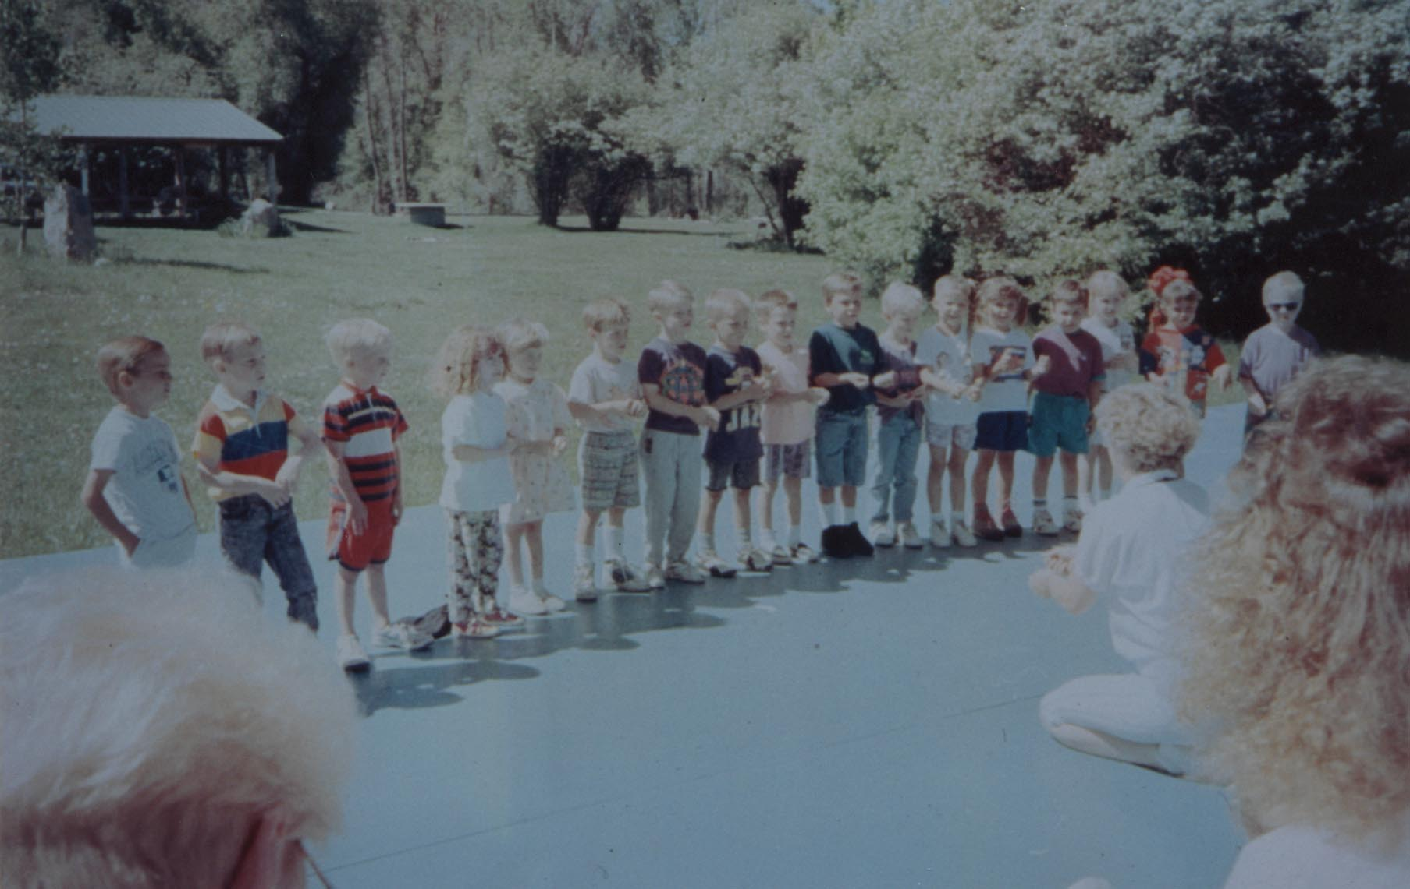
Preschool Graduation Part I

Slide 44
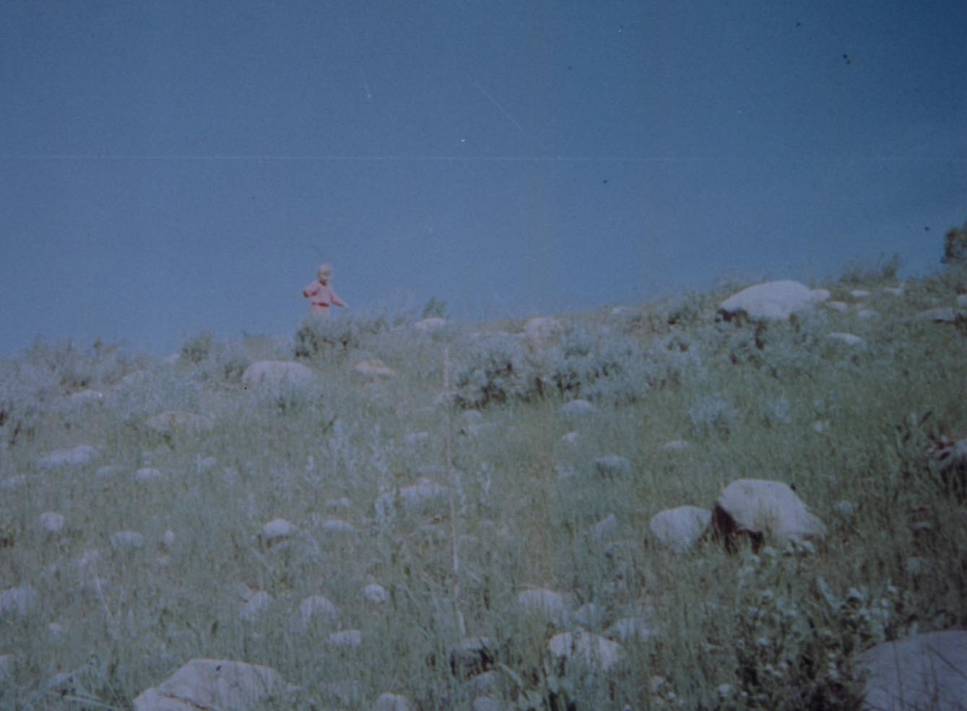
Preschool Graduation Part II

Slide 45
“I’m not afraid about my girlfriends and myself, we’ll squeeze through somehow, though I’m not too certain about my math.” Anne Frank June 21, l942

Slide 46
“I have lots of courage, I feel so strong and as if I can bear a great deal,I feel so free and so young! I was glad when I first realized it, because I don’t think I shall easily bow down before the blows that inevitably come to everyone.” Anne Frank July 15, 1944

Slide 47
Resilience is a developmental process that involves individual differences in children’s attributes (e.g. temperament, cognitive abilities) and environments (e.g. supportive parenting, enriched classrooms).
Kirby Deater-Deckard

Slide 48
Resilience is a process focusing upon strengths to overcome adversity.

Slide 49
Person Attributes Associated With Successful Coping*
Affectionate, engaging temperament.
Sociable.
Autonomous.
Above average IQ.
Good reading skills.
High achievement motivation.
Positive self-concept.
Impulse control.
Internal locus of control.
Planning skills.
Faith.
Humorous.
Helpfulness.
* Replicated in 2 or more studies

Slide 50
Environmental Factors Associated With Successful Coping*
Smaller family size.
Maternal competence and mental health.
Close bond with primary caregiver.
Supportive siblings.
Extended family involvement.
Living above the poverty level.
Friendships.
Supportive teachers.
Successful school experiences.
Involvement in pro-social organizations.
*Replicated in 2 or more studies.

Slide 51
Most Powerful Predictors of a Resilient Child
Easy temperament
Consistent family relationships
Competent caregivers
Development of self-esteem
A sense of emotional security

Slide 52
The pathways that lead to positive adaptation despite high risk and adversity are complex and greatly influenced by context therefore it is not likely that we will discover a magic (generic) bullet.

Slide 53
Resilient children are not simply born that way nor are they made from scratch by their experiences. Genetic and environmental experiences loom large as protectors against a variety of risks to healthy development ranging from resistance to bacteria and viruses to resilience to maltreatment and rejection.
Kirby Deater-Deckard

Slide 54
We fail to appreciate that children are genetically endowed with certain patterns of behavior and thought.

Slide 55
What Are Some of These Traits?
The drive to help.
The drive to mastery.
Intrinsic motivation and instinctual optimism.
Altruism.
Problem solving.
Social connection.
The drive to acquire knowledge.

Slide 56
Five Strategies To Foster a Resilient Mindset
Teach empathy by practicing empathy.
Teach responsibility by encouraging contributions.
Teach decision making and problem solving skills that foster self-discipline.
Offer encouragement and positive feedback.
Help children deal with mistakes.

Slide 57
Teach Empathy By Practicing Empathy
Are we saying or acting in a way that our children will be responsive to hearing us?
Would we want anyone to speak to us the way we speak to our children?
How would our children describe us at various times?
How would we want our children to describe us?

Slide 58
Teach Empathy By Practicing Empathy
Listen
Validate
Avoid preaching and lecturing
Avoid judgments and accusations
Put yourself in their shoes
Change your negative scripts

Slide 59
Teach Responsibility By Encouraging Contributions
Provide ample opportunity
Focus on existing success
Build islands of competence
Allow the opportunity to witness concrete examples of success

Slide 60
Teach Decision Making and Problem Solving Skills That Reinforce Self-Discipline
What’s my problem?
What solutions are available?
Which solution is the best?
How can I implement each step of the solution?
How did I do?

Slide 61
Offer Encouragement and Positive Feedback
Become a charismatic adult
Provide realistic appreciation
Focus on building rather than tearing down
Be available

Slide 62
Help Children Deal With Mistakes
The fear of mistakes is a strong roadblock to developing a resilient mindset
Mistakes are opportunities to learn
Model the benefits of mistakes

Slide 63
Do Children Care What We Think? Part I

Slide 64
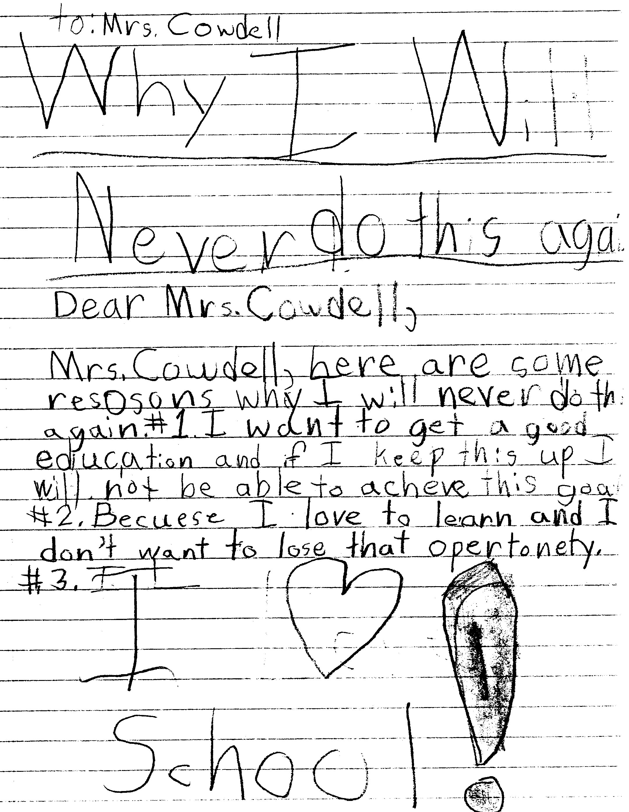
Do Children Care What We Think? Part II

Slide 65
Stress Hardiness
Committed to finding a meaningful purpose in life.
A belief that you can influence your surroundings and outcome of events,
A belief that you can learn and grow from both positive and negative life experiences.

Slide 66
Focus on Well Being!
COMPETENCE in academic, social and vocational areas
CONFIDENCE or a positive identity
CONNECTIONS or healthy relations
CHARACTER or positive values, integrity, and values
CARING and compassion
(Lerner et al, 2000)

Slide 67
Adopt a learning to swim mindset!

Slide 68
The Mindset of a Resilient Youth
Optimistic and hopeful.
Feel special and appreciated in the eyes of others.
Set realistic goals and expectations.
View mistakes, hardships and obstacles as challenges.
Solve problems and make decisions.
Internal locus of control.
Believe you can and set out to solve problems.
Possess empathy.

Slide 69
www.samgoldstein.com info@samgoldstein.com

