Slide 1

Sustaining Your Resilience in Stressful Times: Guidelines for Pediatric Mental Health Professionals
Sam Goldstein, Ph.D.
Assistant Clinical Professor
University of Utah School of Medicine
www.samgoldstein.com
info@samgoldstein.com
@drsamgoldstein
@doctorsamgoldstein

Slide 2
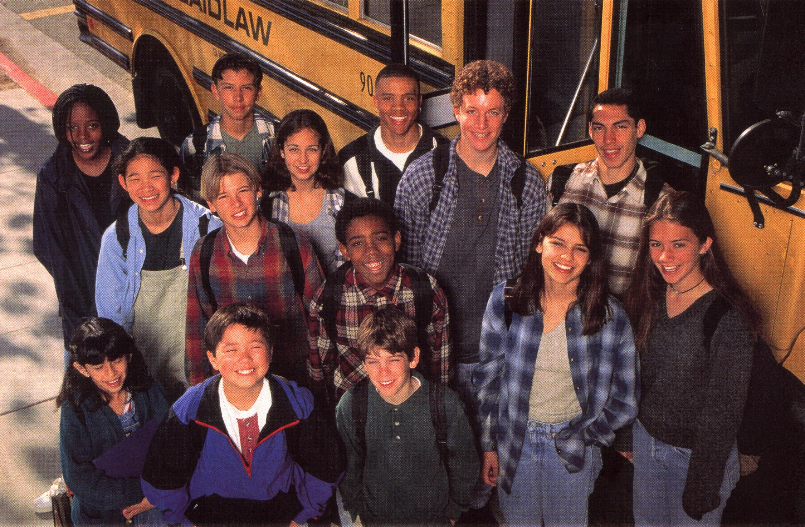
The Future

Slide 3

A man goes fishing.

Slide 4

The purpose of life is to prepare the next generation for their future.

Slide 5
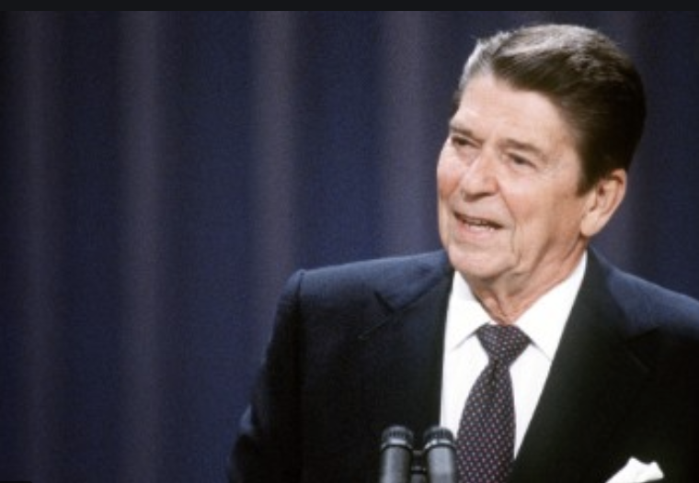
There are no constraints on the human mind, no walls around the human spirit,
no barriers to our progress except those we ourselves erect.
-Ronald Reagan

Slide 6

Resilience is a process focusing upon strengths
to overcome adversity.

Slide 7
Resilience
A process leading to good
outcome despite high risk
The ability to function competently under stress
The ability to recover from
trauma and adversity
Notes:
On a paper and pencil test, the sample of behavior refers to an individual's performance on a series of tasks or items.
This performance produces a test score that reflects the specific psychological construct being measured, such as cognitive ability, achievement, personality, or emotional functioning.

Slide 8
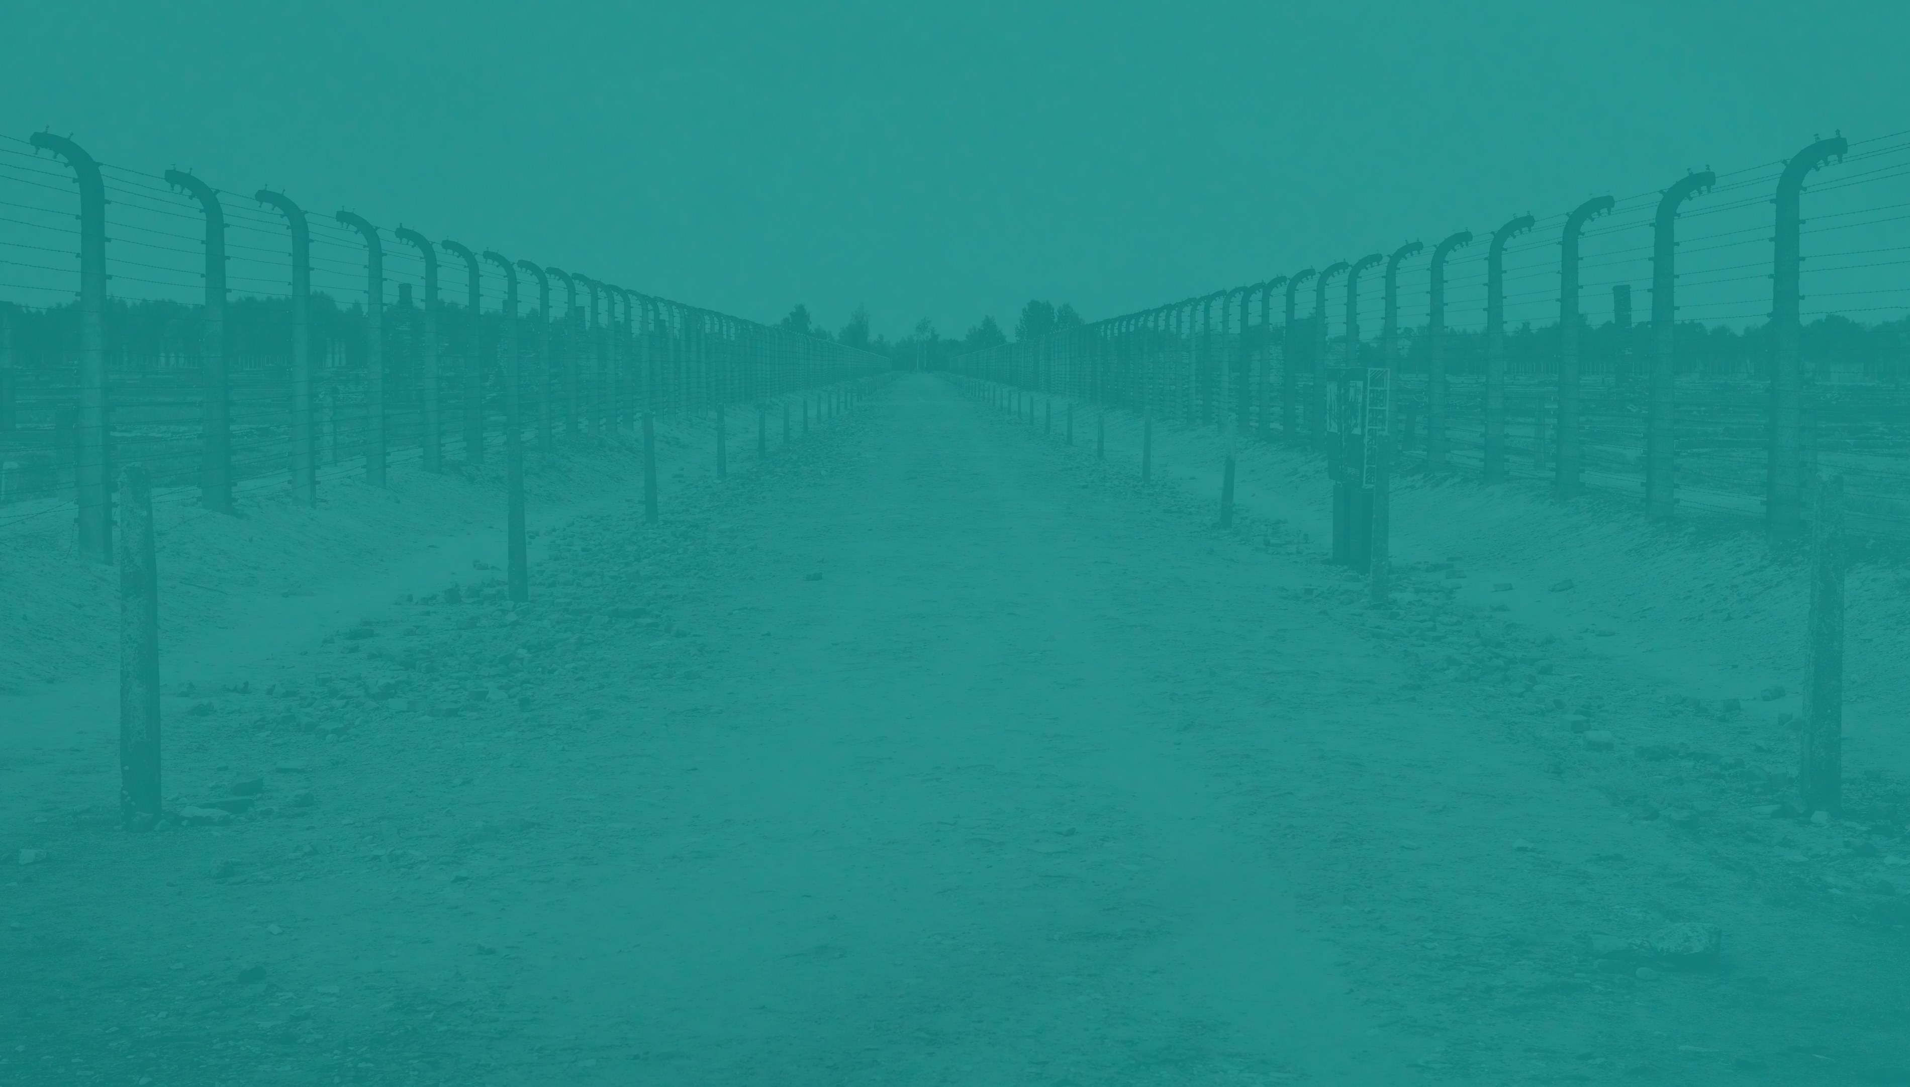
“I’m not afraid about my girlfriends and myself, we’ll squeeze through somehow, though I’m not too certain about my math.”
Anne Frank
June 21, 1942

Slide 9

“I have lots of courage, I feel
so strong and as if I can bear a great deal, I feel so free and so young! I was glad when I first realized it, because I don’t think
I shall easily bow down before the blows that inevitably come
to everyone.”
Anne Frank
July 15, 1944

Slide 10
Predictors of Resilience
Living above the poverty level
Not experiencing a learning disability
Easy temperament
Competent parents
Available parents
Warm parental relationship
Social relations
Notes:
On a paper and pencil test, the sample of behavior refers to an individual's performance on a series of tasks or items.
This performance produces a test score that reflects the specific psychological construct being measured, such as cognitive ability, achievement, personality, or emotional functioning.

Slide 11
Predictors of Resilience
(cont.)
Educational opportunity
Organized religious affiliation
Higher intellect
Learning to problem solve
Internal locus of control
Sense of self-worth
Sense of humor
Notes:
On a paper and pencil test, the sample of behavior refers to an individual's performance on a series of tasks or items.
This performance produces a test score that reflects the specific psychological construct being measured, such as cognitive ability, achievement, personality, or emotional functioning.

Slide 12

Most Powerful Predictors of a Resilient Child
Easy temperament
Consistent family relationships
Competent caregivers
Development of self-esteem
A sense of emotional security
Notes:
On a paper and pencil test, the sample of behavior refers to an individual's performance on a series of tasks or items.
This performance produces a test score that reflects the specific psychological construct being measured, such as cognitive ability, achievement, personality, or emotional functioning.

Slide 13
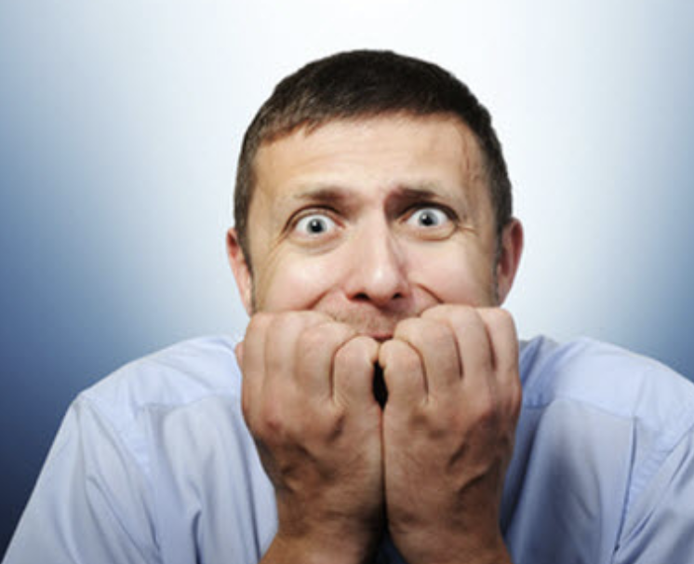
Andy’s Story

Slide 14
Corona
Virus Stress Syndrome (CoViSS)
Unlike the 9/11 tragedy, an unexpected, sudden event, the
virus pandemic has evolved at a slow creep until critical thresholds were reached and governments began to act.
Even then their actions have rolled out slowly over days and weeks until our country is coming to a halt, much like a speeding train trying to slow down before a downed bridge.
Notes:
On a paper and pencil test, the sample of behavior refers to an individual's performance on a series of tasks or items.
This performance produces a test score that reflects the specific psychological construct being measured, such as cognitive ability, achievement, personality, or emotional functioning.

Slide 15
Corona
Virus Stress Syndrome (CoViSS)
(cont.)
Further, the rapid growth of technology in the past 20 years is such that nearly every citizen has access to the web and television instantly on their phones.
Cable news stations are devoting 24-hour coverage of the pandemic. For better or worse, we have truly become a global village. As with this teen’s father, I think we are beginning to see some of our children, friends, family and neighbors succumb to these events.
Notes:
On a paper and pencil test, the sample of behavior refers to an individual's performance on a series of tasks or items.
This performance produces a test score that reflects the specific psychological construct being measured, such as cognitive ability, achievement, personality, or emotional functioning.

Slide 16
Corona
Virus Stress Syndrome (CoViSS)
Spending hours on end watching news channels.
Spending hours posting and reposting events related to the pandemic.
Buying household products, foods, etc., that far exceed immediate need.
Setting alerts on your phone for every news channel.
Repeatedly texting friends,
family and coworkers about
related news events.
Notes:
i.e., Behavioral data that is often collected through technology, which includes wearables, social media, etc.

Slide 17
Corona
Virus Stress Syndrome (CoViSS)
Repeatedly making dire posts
on social media.
Making the pandemic all you can speak about with others.
Ignoring daily responsibilities.
Ignoring hygiene, rest and food.
Notes:
i.e., Behavioral data that is often collected through technology, which includes wearables, social media, etc.

Slide 18
Stress and Illness
Stress and illness have intersecting components. Many studies indicate such a link.
Theories of the stress–illness link suggest that both acute and chronic stress can cause illness, and lead to changes in mental and physical health, behavior and how the
body functions.
Notes:
i.e., Behavioral data that is often collected through technology, which includes wearables, social media, etc.

Slide 19
Stress and Illness
(cont.)
Research indicates the type of stressor, whether it is acute or chronic, and individual person characteristics, such as age and physical well-being, before the onset of the stressor can combine to determine the effect of stress on an individual.
A person’s personality, genetics
and childhood experiences, including possible major stressors and traumas, may also predispose their response to an event such as a viral pandemic.
Notes:
i.e., Behavioral data that is often collected through technology, which includes wearables, social media, etc.

Slide 20
Impact of Quarantine and Isolation
Increased social isolation.
Increased problems with
school work.
Depression and/or anxiety.
Health fears.
Frustration and boredom.
Notes:
i.e., Behavioral data that is often collected through technology, which includes wearables, social media, etc.

Slide 21
Corona
Virus Stress Syndrome (CoViSS)
If these symptoms fit you, a family member or a loved one, don’t despair.
The lesson we learned from 9/11 is that most people over time draw strength from family and friends and eventually return to more normal behavior.
However, it never hurts to bring your concerns about yourself to a mental health professional if you experience CoViSS, or to speak to a friend or family member in whom you recognize these signs.
Notes:
i.e., Behavioral data that is often collected through technology, which includes wearables, social media, etc.

Slide 22
I Suggest for You:
Limit your news-watching to a
½ hour per day.
Turn off all alerts from news channels on your devices.
Exercise.
Attend to daily responsibilities.
Work if you can.
Notes:
i.e., Behavioral data that is often collected through technology, which includes wearables, social media, etc.

Slide 23
I Suggest for You:
(cont.)
Keep busy with family activities
even if restricted to home.
Resist posting or texting bad news.
Reassure your children that the world isn’t ending.
Consider a budget for spending
over the next 3 months if needed.
Notes:
i.e., Behavioral data that is often collected through technology, which includes wearables, social media, etc.

Slide 24
Guidelines for Quarantine
Information is key; people who are quarantined need to understand the situation.
Effective and rapid communication is essential.
Supplies (both general and medical) need to be provided.
The quarantine period should be
short, and the duration should not
be changed unless in extreme circumstances.
Notes:
i.e., Behavioral data that is often collected through technology, which includes wearables, social media, etc.

Slide 25
Guidelines for Quarantine
(cont.)
Most of the adverse effects come from the imposition of a restriction
of liberty; voluntary quarantine is associated with less distress and fewer long-term complications.
Public health officials should emphasize the altruistic choice of
self-isolating.
Notes:
i.e., Behavioral data that is often collected through technology, which includes wearables, social media, etc.

Slide 26
I Suggest for the Youth You Work With:
Communicate the facts as is age appropriate.
Have parents make time to talk.
Reframe the current stress.
Look into the future.
Help children think logically.
Listen for catastrophic thinking.
Offer empathy.
Model problem solving.
Teach relaxation.
Notes:
i.e., Behavioral data that is often collected through technology, which includes wearables, social media, etc.

Slide 27

The late singer-songwriter Tom Petty wrote in his classic song “Crawling Back to You,” Most things I worry about never happen anyway.

Slide 28
Who We Are
Worry is in our genes. It keeps us
alert and aware of danger.
But worry can also consume us if we are not vigilant and proactive, further complicating challenging situations and times.
But so too is hope, optimism, motivation and empathy, the foundations of resilience.
Notes:
i.e., Behavioral data that is often collected through technology, which includes wearables, social media, etc.

Slide 29

Resilience is about functioning adequately during challenging times. It is a resource we all possess and most certainly must harness in these difficult times.
Notes:
i.e., Behavioral data that is often collected through technology, which includes wearables, social media, etc.

Slide 30

Goldstein’s Axiom
Through intelligent and ethical educational and therapeutic practices, we can foster self-discipline, mental health and resilience in ourselves and our students without stealing away their dignity and hope.
Notes:
i.e., Behavioral data that is often collected through technology, which includes wearables, social media, etc.

Slide 31
Five Strategies to Foster a Resilient Mindset
Teach empathy by practicing empathy.
Teach responsibility by encouraging contributions.
Teach decision-making and
problem-solving skills that foster
self-discipline.
Offer encouragement and positive feedback.
Help children deal with mistakes.
Notes:
i.e., Behavioral data that is often collected through technology, which includes wearables, social media, etc.

Slide 32
Teach Empathy by Practicing Empathy
Are we saying or acting in a way
that our children will be responsive to hearing us?
Would we want anyone to speak
to us the way we speak to our children?
How would our children describe
us at various times?
How would we want our children
to describe us?
Notes:
i.e., Behavioral data that is often collected through technology, which includes wearables, social media, etc.

Slide 33

Teach Empathy by Practicing Empathy
(cont.)
Listen
Validate
Avoid preaching and lecturing
Avoid judgments and accusations
Put yourself in their shoes
Change your negative scripts
Notes:
i.e., Behavioral data that is often collected through technology, which includes wearables, social media, etc.

Slide 34
Teach Responsibility by Encouraging Contributions
Provide ample opportunity
Focus on existing success
Build islands of competence
Allow the opportunity to witness concrete examples of success
Notes:
i.e., Behavioral data that is often collected through technology, which includes wearables, social media, etc.

Slide 35
Teach Decision-Making and Problem-Solving
Skills That Reinforce Self-Discipline
What’s my problem?
What solutions are available?
Which solution is the best?
How can I implement each step
of the solution?
How did I do?
Notes:
i.e., Behavioral data that is often collected through technology, which includes wearables, social media, etc.

Slide 36
Offer Encouragement and Positive Feedback
Become a charismatic adult
Provide realistic appreciation
Focus on building rather than
tearing down
Be available
Notes:
i.e., Behavioral data that is often collected through technology, which includes wearables, social media, etc.

Slide 37

Help Children Deal With Mistakes
The fear of mistakes is a strong roadblock to developing a resilient mindset
Mistakes are opportunities to learn
Model the benefits of mistakes
Notes:
i.e., Behavioral data that is often collected through technology, which includes wearables, social media, etc.

Slide 38
The Mindset of a Resilient Child
Optimistic and hopeful.
Feel special and appreciated in
the eyes of others.
Set realistic goals and expectations.
View mistakes, hardships and obstacles as challenges.
Solve problems and make decisions.
Internal locus of control.
Believe you can and set out to
solve problems.
Possess empathy.
Notes:
i.e., Behavioral data that is often collected through technology, which includes wearables, social media, etc.

Slide 39
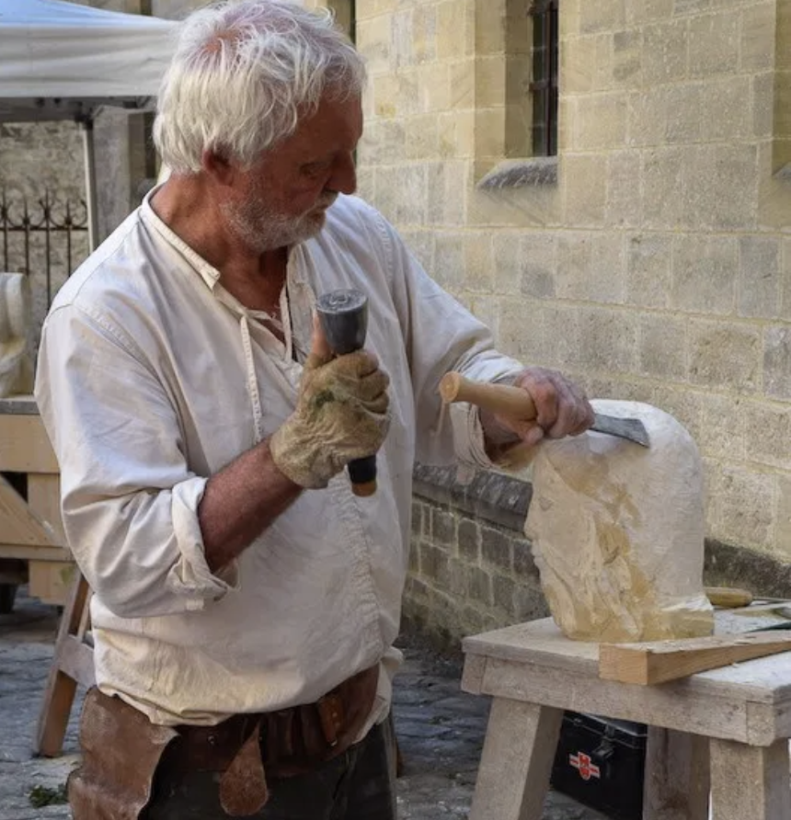
Creating a Masterpiece!

Slide 40
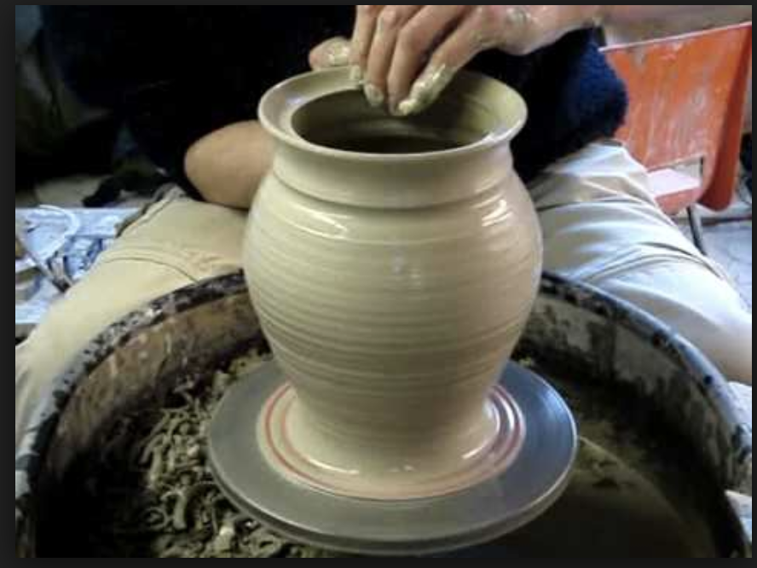
Creating a Masterpiece!

Slide 41

May our philosophies keep pace with our technologies. May our compassion keep pace with our powers. And may love, not fear, be the engine of change.
-Dan Brown, Origin

Slide 42

Children are living messages we send to a time and place we will never see.
-Neil Postman, The Disappearance of Childhood

Slide 43

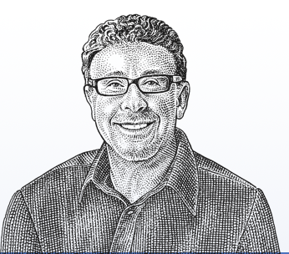
Questions?
Sam Goldstein
www.samgoldstein.com
info@samgoldstein.com
@drsamgoldstein
@doctorsamgoldstein
https://www.youtube.com/watch?v=isfw8JJ-eWM

